Slide 1
MACHINE LEARNING: WITH THE REVOLUTION
Ibet Hernandez, Stephanie Plaza, Vanessa Simpson, Victoria Cruz

Slide 2
WHY MUSIC?
STORAGE / TECH
SPECTROGRAMS, ETC.
BECAUSE 2020
Access to shared audio files both legal and illegal have transformed the availability of recorded music.
We built a MIR (Music Information Retrieval System) which produced spectrograms from our analysis, but there are numerous ways audio datasets can be worked with.
It’s been an interesting year, we could all use a good jam!

Slide 3
BIG, BAD, DATA?

Slide 4
SAMPLE SIZES
A 5 second music sample was chosen from the following genres:
Blues, classical, country, disco, hip-hop, jazz, metal, pop, reggae, and rock
The initial size of the sample was 30 second clips but had be trimmed down due to time and storage constraints.
10 genres with 100 clips for each = 1000 clips took an estimate of 7 hours to fully download.

Slide 5
FINDING THAT CLOSE ENOUGH MODEL
Vanessa used 3 models and 5 test samples.
Neural Network returned Jazz for each sample
K Nearest Neighbor returned Pop for each sample
SVC predicted a different genre each time it was ran but did not predict the correct genre

Slide 6
SUCCESS
We managed to pick an initially fairly straightforward data set to work with:
Very little formatting or editing needed to be done for initial setup.
There were other projects that had been done with the same topic and we were able to pick some ideas from them.
However, the file size and data storage of audio files can get large and messy quick!

Slide 7
OPPORTUNITIES
The main opportunity was finding a model that would project the genre correctly.
Printing the spectrograms, learning how audio files are similar/different from other data types.
Connection of the model to Flask app.
Learning that audio file sizes matter, even when trying to deploy your app.

Slide 8
HOW DOES IT WORK?

Slide 9
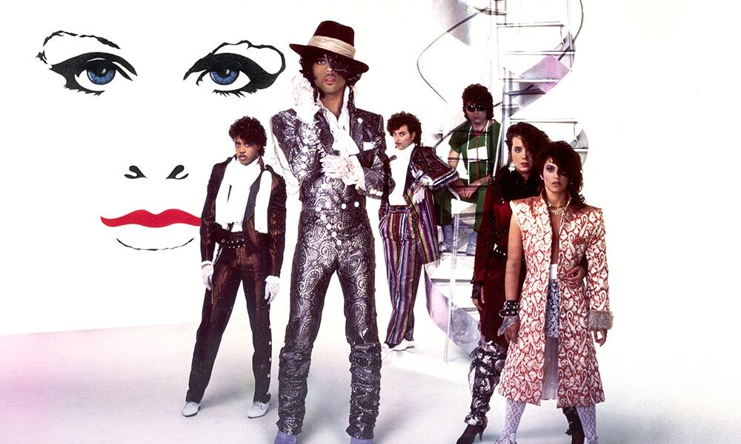
A PICTURE IS WORTH A THOUSAND WORDS

